Slide 1
19CSE211
Session 9 to 12
MIPS single Cycle Data Path
Supporting Slides
02-02-2021

Slide 2
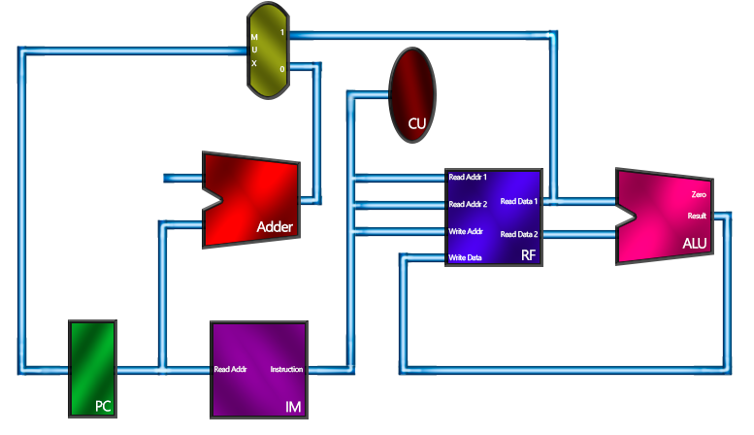
https://www3.ntu.edu.sg/home/smitha/FYP_Gerald/rDatapath.html

Slide 3
Find the MIPS Instructions
00000 00010 00011 00100 00000 100100
001000 00101 00110 0010 1010 1110 1111

Slide 4
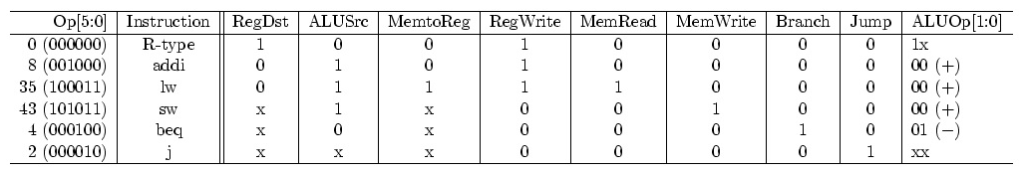
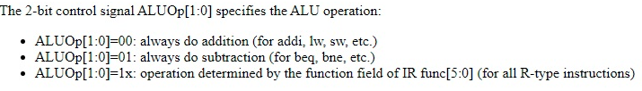
Based on the Opcode field ( the highest 6 bits of the 32 bit instruction), the control unit of the CPU is to generate all the control signals to coordinate operations in various parts of the CPU.

Slide 5
Target Address calculation
Branch Instruction

Slide 6
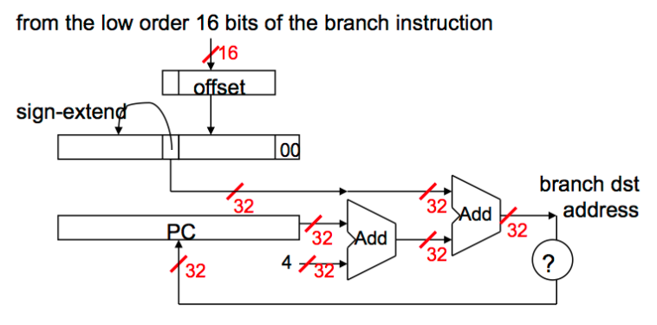
beq | rs, rt, label | Opcode is 000100 | Label is a 16 Bit value
Note that our immediate field is only 16-bits so we can’t specify a full 32-bit target
address. So we have to do a few things before jumping.
• The immediate field is left-shifted by two because the immediate represents the
number of words offset from PC+4, not the number of bytes.
We sign-extend the immediate field to 32-bits and add it to PC+4.

Slide 7
Find the instruction
000100 00100 00101 0001 1111 0000 1010
Find the target address also

Slide 8
Target Address calculation
Jump Instruction

Slide 9
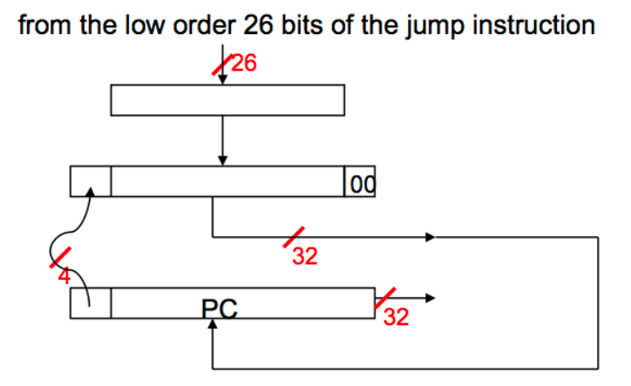
For Jump instruction MIPS has only 26 bits to determine Jump location. Jumps are relative to PC in MIPS. Like branch, immediate jump value needs to be word-aligned; therefore, we need to multiply 26 bit address with four.
Again step by step:
Multiply 26 bit value with 4.
Since we are jumping relative to PC+4 value, concatenate first four bits of PC+4 value to left of our jump address.
Resulting address is the jump value.
In other words, replace the lower 28 bits of the PC + 4 with the lower 26 bits of the fetched instruction shifted left by 2 bits.

Slide 10
Find the instruction
000010 00 0000 1111 0101 1010 1100 0011
Find the target address also

Slide 11
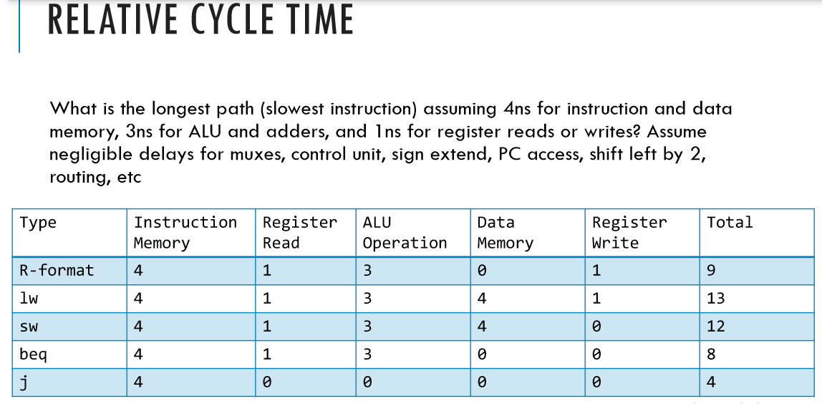

Slide 12
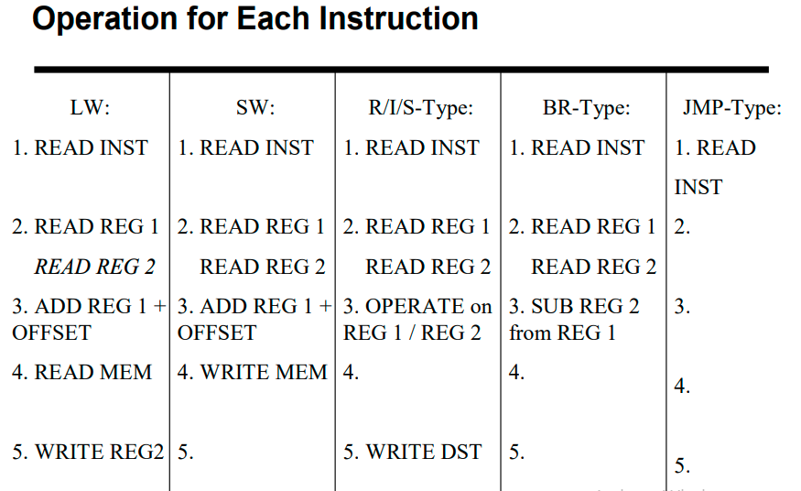
https://www.d.umn.edu/~gshute/mips/instruction-types.xhtml
https://www.scss.tcd.ie/Jeremy.Jones/VivioJS/dlx/dlx.htm
https://minnie.tuhs.org/CompArch/Resources/mips_quick_tutorial.html

Slide 13
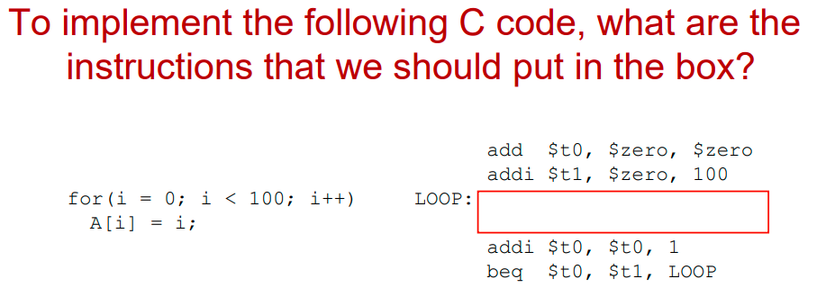

Slide 14
Write MIPS ALP Code for(i = 0; i < 100; i++)
{ sum+=A[i];
}

Slide 15
Execution times of hardware blocks of a single cycle data-path are as follows:
Program counter write 5ps
Multiplexer 2ps
Control 3ps
Register file read or write 15ps
Sign extension 2ps
Shift left by 2 2ps
Adder or ALU 20ps
Instruction/data memory read or write 20ps
All other hardware times can be neglected.
Find a lower bound on the cycle time for the program counter.
Note lower bound on the cycle time for the PC > Total time taken for the ??? instruction.

Slide 16
Execution times of hardware blocks of a single cycle data-path are as follows:
Program counter write 5ps
Multiplexer 2ps
Control 3ps
Register file read or write 15ps
Sign extension 2ps
Shift left by 2 2ps
Adder or ALU 20ps
Instruction/data memory read or write 20ps
All other hardware times can be neglected.
Find a lower bound on the cycle time for the program counter.
Note lower bound on the cycle time for the PC > Total time taken for the lw instruction.

